Slide 1
Modular extension

Slide 2
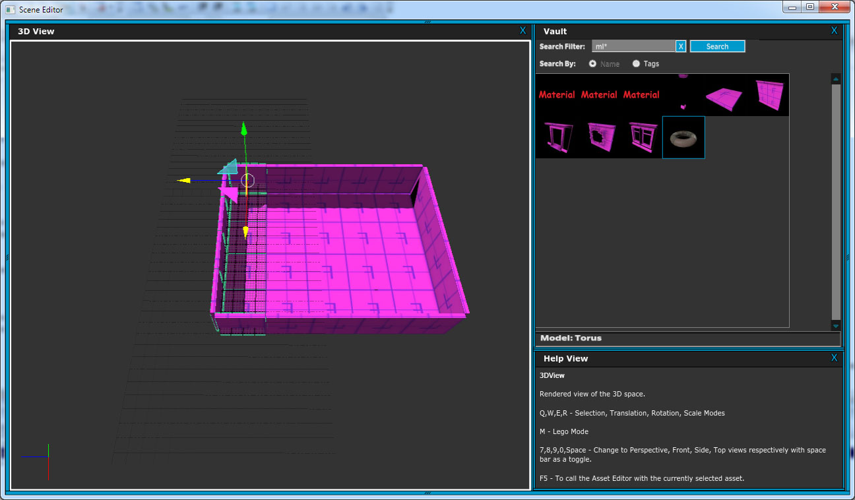
Select the edge pieces.
Hit hot key to switch to “modular extension mode”

Slide 3
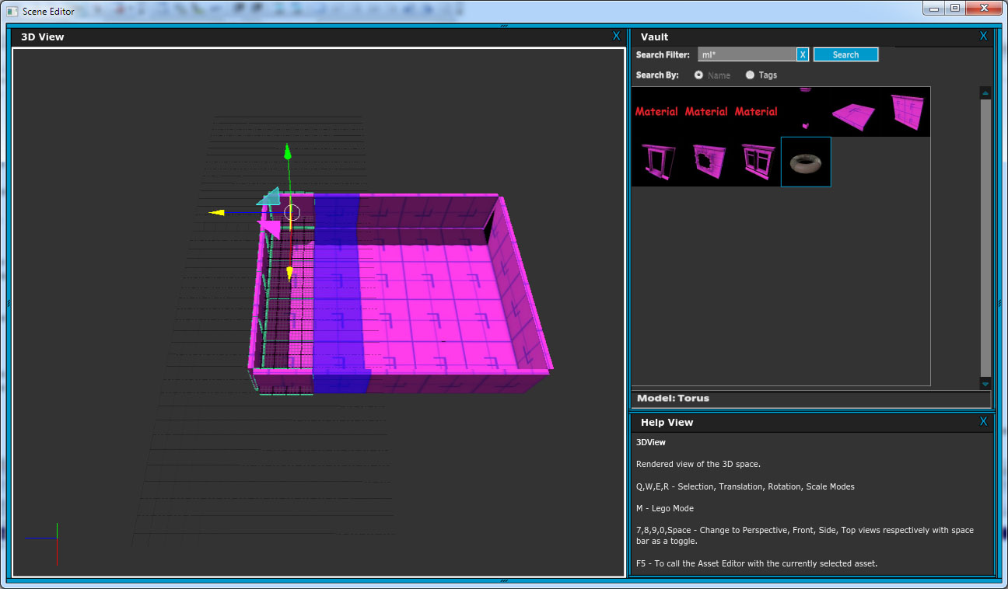
Select the plane handle for the direction to extend.
Tool selects one level deep of connected pieces along that plane. (Could hotkey to follow additional levels.)

Slide 4
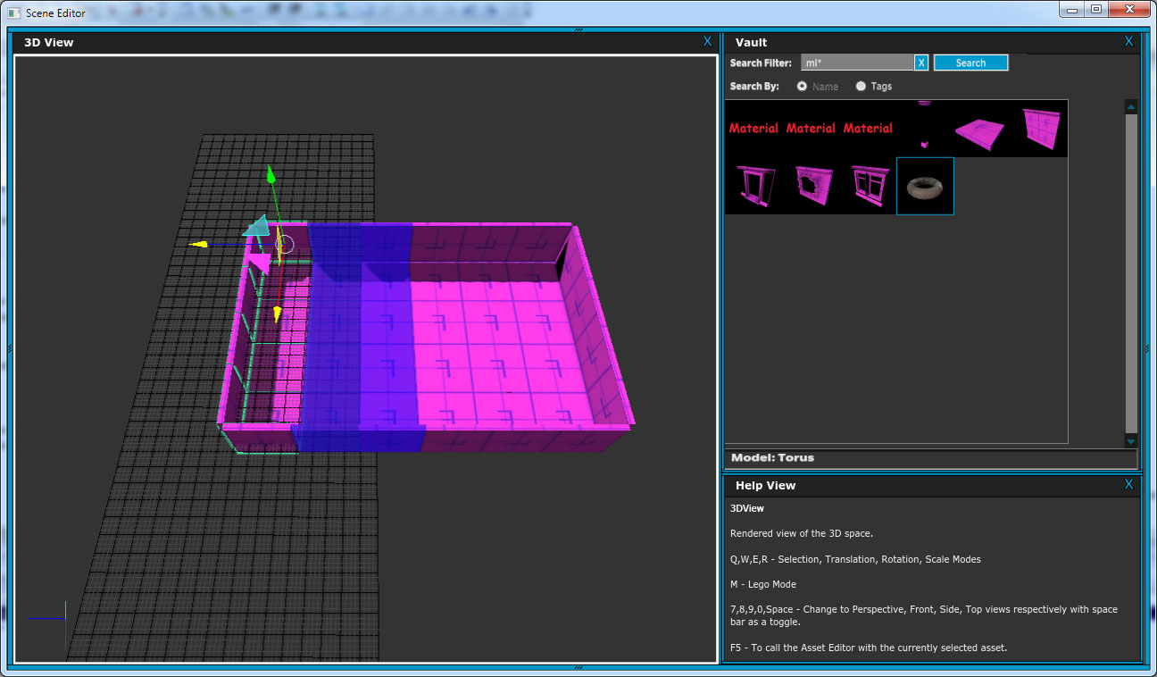
Drag plane handle. Selected pieces snap one full tile.

Slide 5
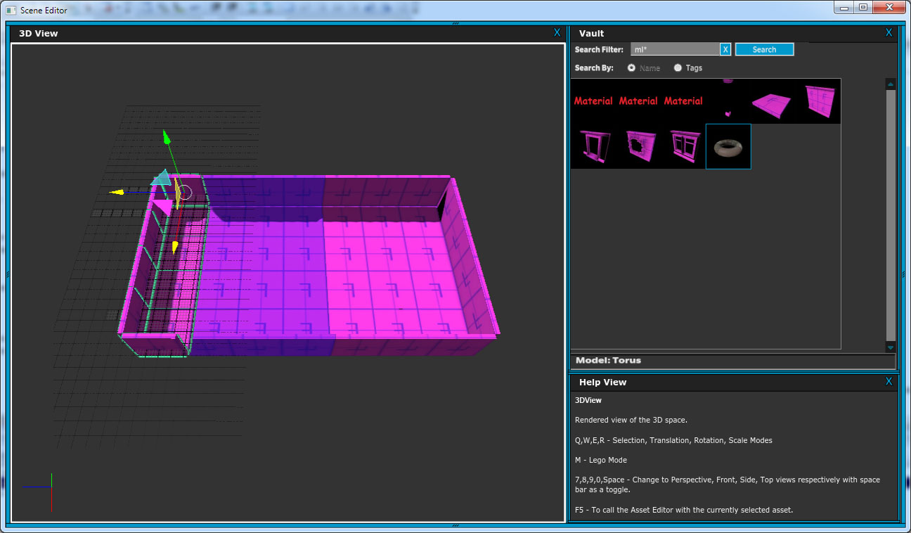
Keep dragging a bit, another tile snaps into place.

Slide 6
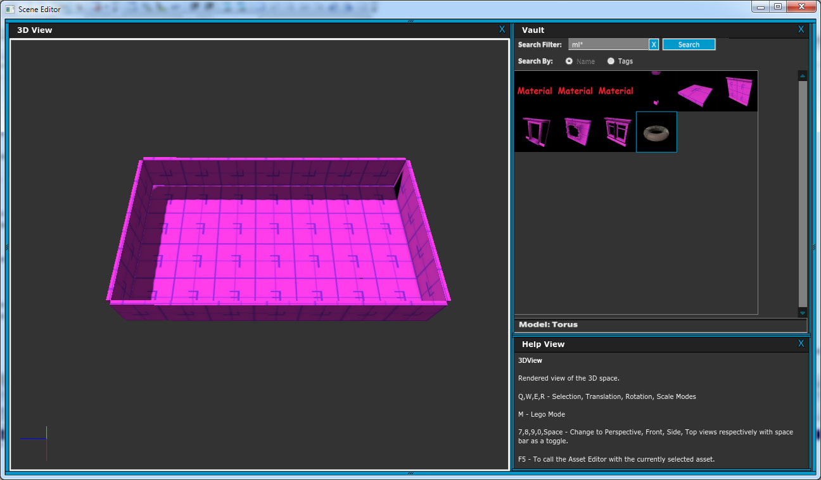
There you go. Bigger area.

Slide 7
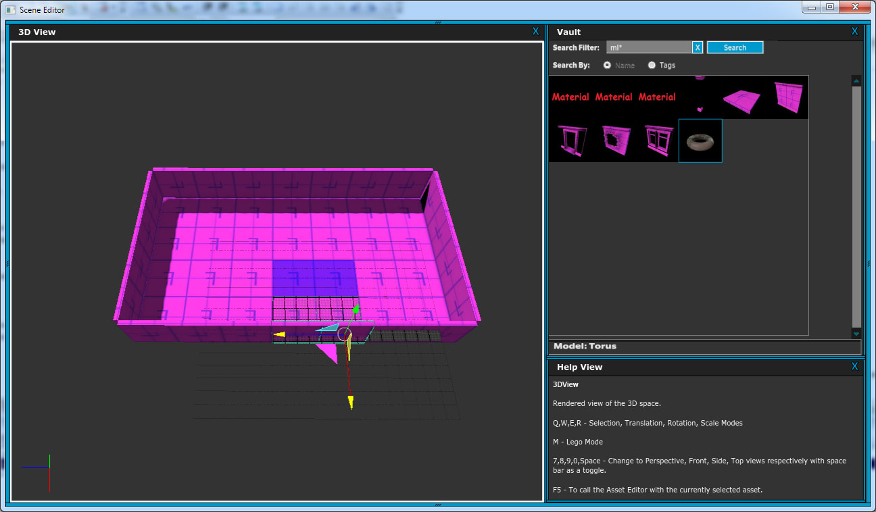
Select edge pieces.
Click on XZ plane handle.

Slide 8
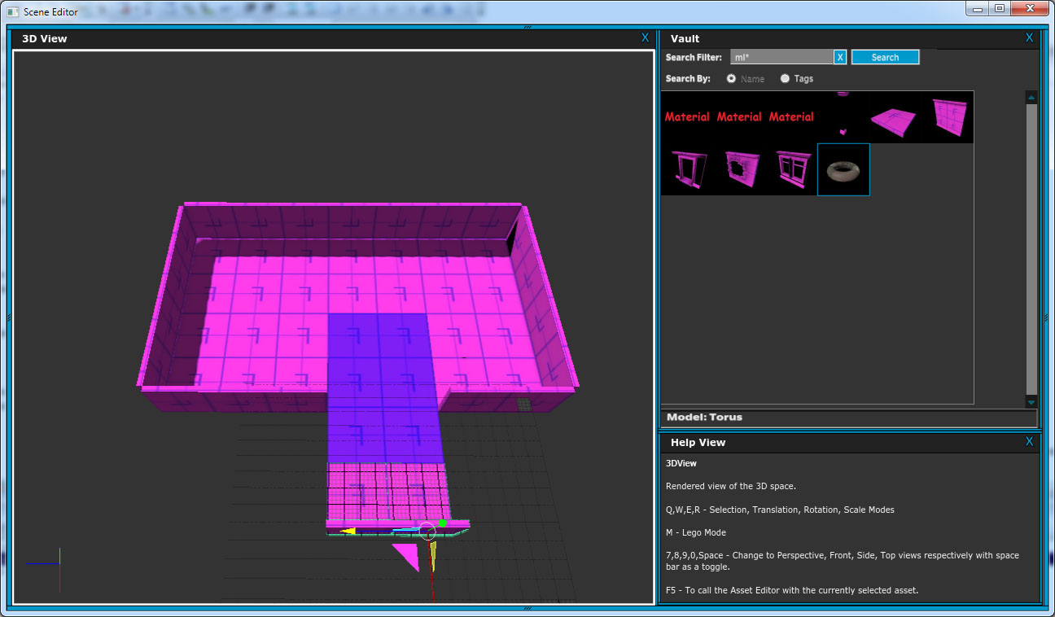
Drag handle down to extend hallway.

